Slide 1
Band Lookup Final Project
By Sam Bennett, John Dennison, Caleb Massey, and Jackson O’Dell

Slide 2
System Description
Provides an easy lookup system for customers to find
Bands
Albums
Specific Genres
Merchandise
The system allows customers to order multiple albums and varying merchandise in one order.
Customers can order three different types of merchandise
Sweatshirts
Shirts
Hats
Each one comes in different styles and sizes

Slide 3
System Description: Typical Queries
One of the main purposes of the service is to allow customers to find albums and merchandise of a single band that they are interested in
The database will be queried to display all albums and merchandise that have the same band_id as the band searched by the customer
When a customer places an order, the album and merchandise id’s need to be added to the order
An insert statement will add new rows to the orders table in order to add all the products to the order.
After an order is completed, the information is stored in the customer’s information for easy access
The database is updated to add the new order to the customer

Slide 4
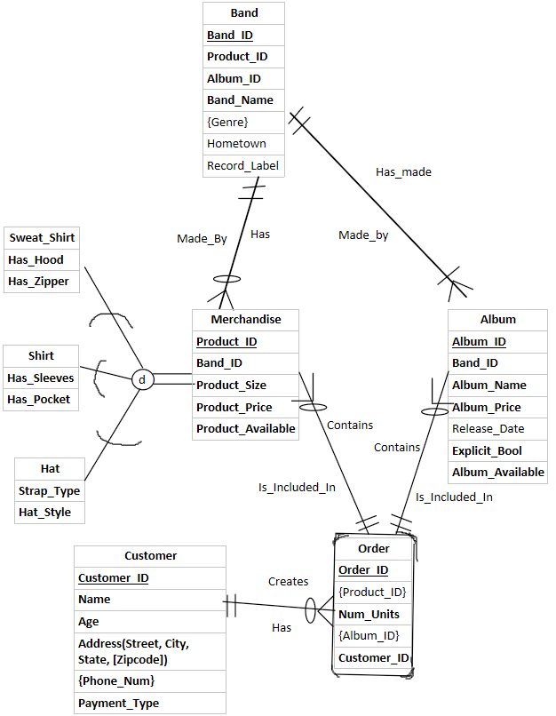
ER Diagram

Slide 5
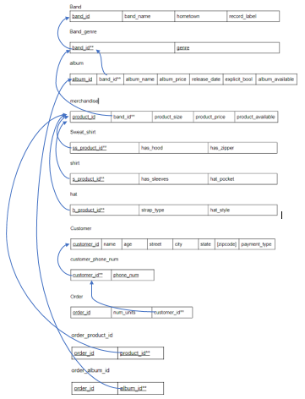
Relational Model

Slide 6
Implementation
We will now show you a few examples of the data stored in our database.

